Slide 1
Cost Report: Problems and Solutions
Presented by David Dean, Rapid Solutions Group, Inc.
Rapid Solutions Group, Inc.
WWW.RAPSG.COM
407-523-9231
David Dean
DDEAN@RAPSG.COM
Notes:
This presentation demonstrates the new capabilities of PowerPoint and it is best viewed in Slide Show. These slides are designed to give you great ideas for the presentations you’ll create in PowerPoint 2010!
For more sample templates, click the File tab, and then on the New tab, click Sample Templates.

Slide 2
Enhancing Your Cost Report Experience
1
2
3
Finance Load Spreadsheet
Early Processing of Cost Report
FISH File Interface

Slide 3
Finance Load Spreadsheet
1
Where did that number come from?

Slide 4
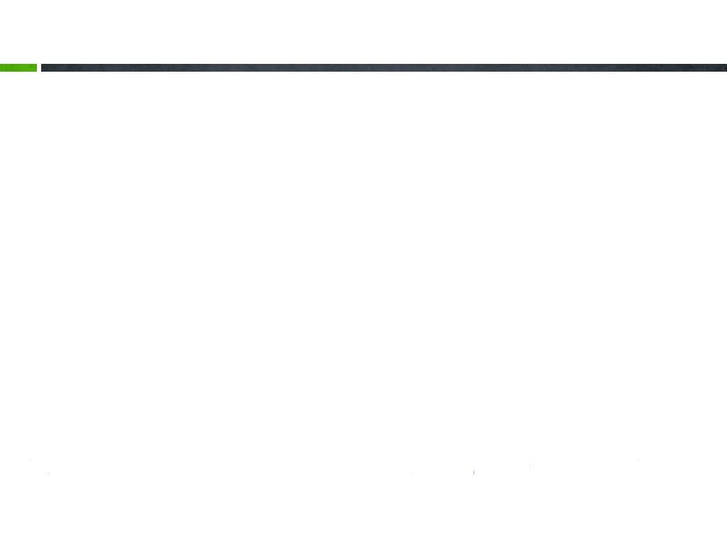
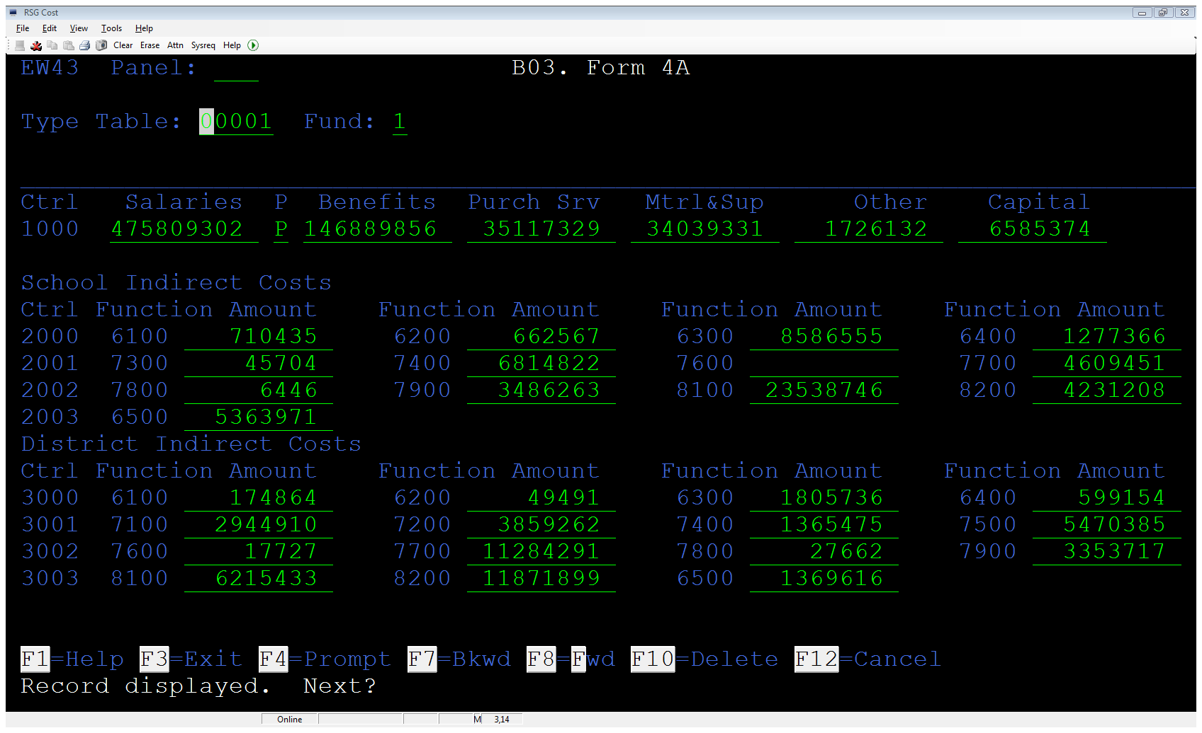
Finance Load Spreadsheet (Example #1)

Slide 5
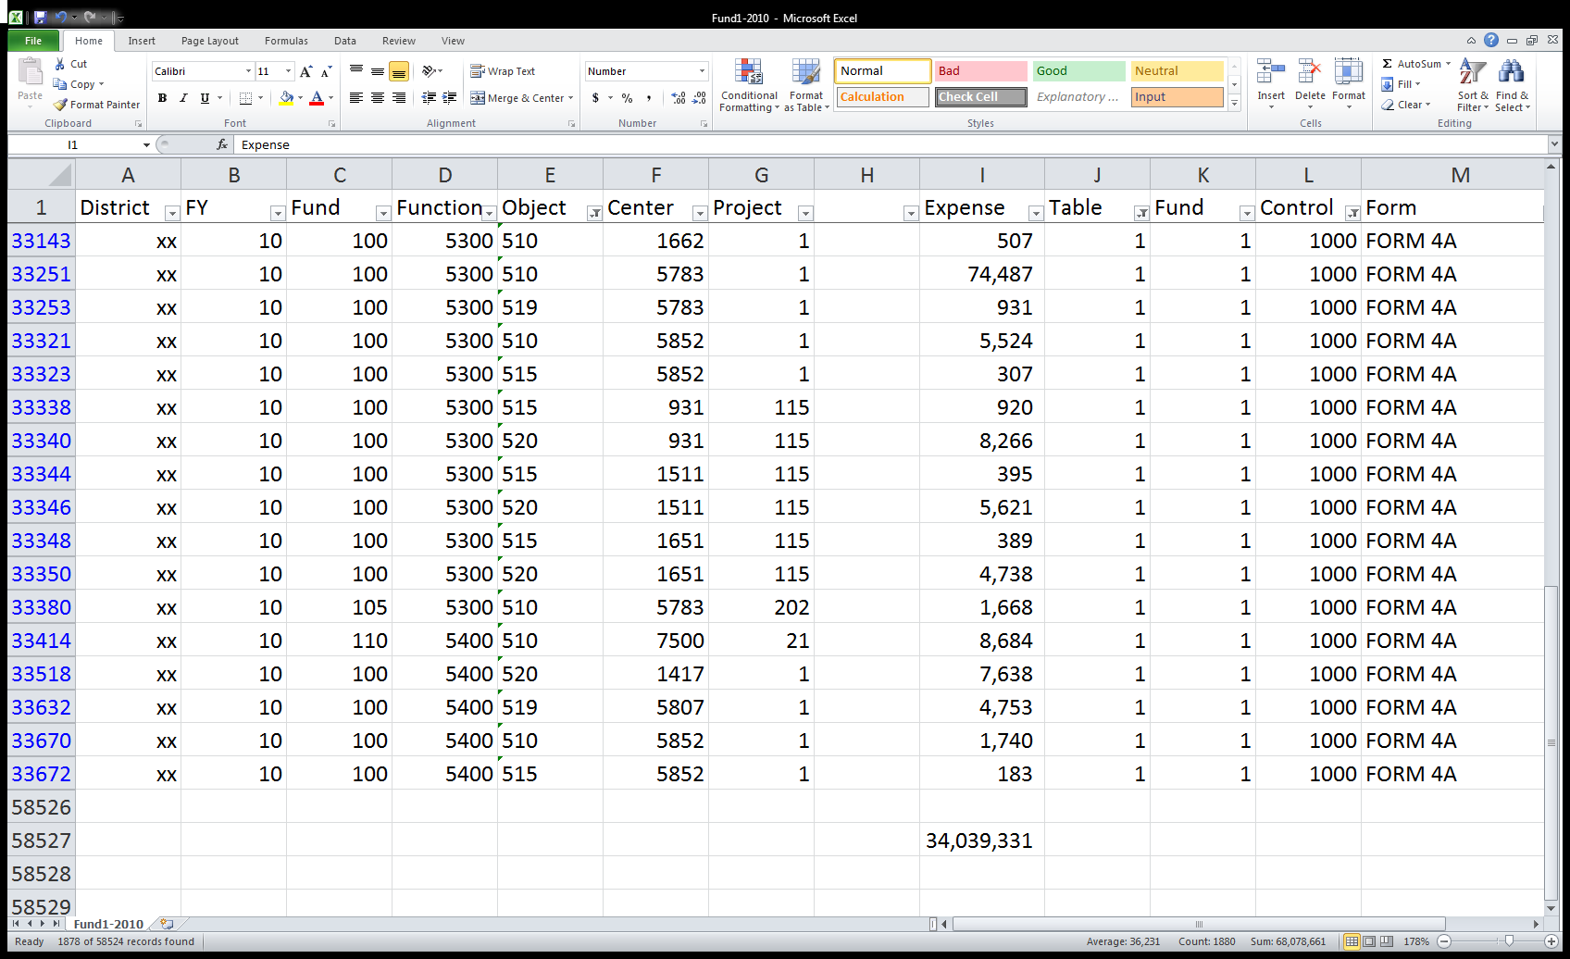
Finance Load Spreadsheet (Example #1)
Object 5xx
Table 00001
Control1000

Slide 6
Finance Load Spreadsheet (Example #2)

Slide 7
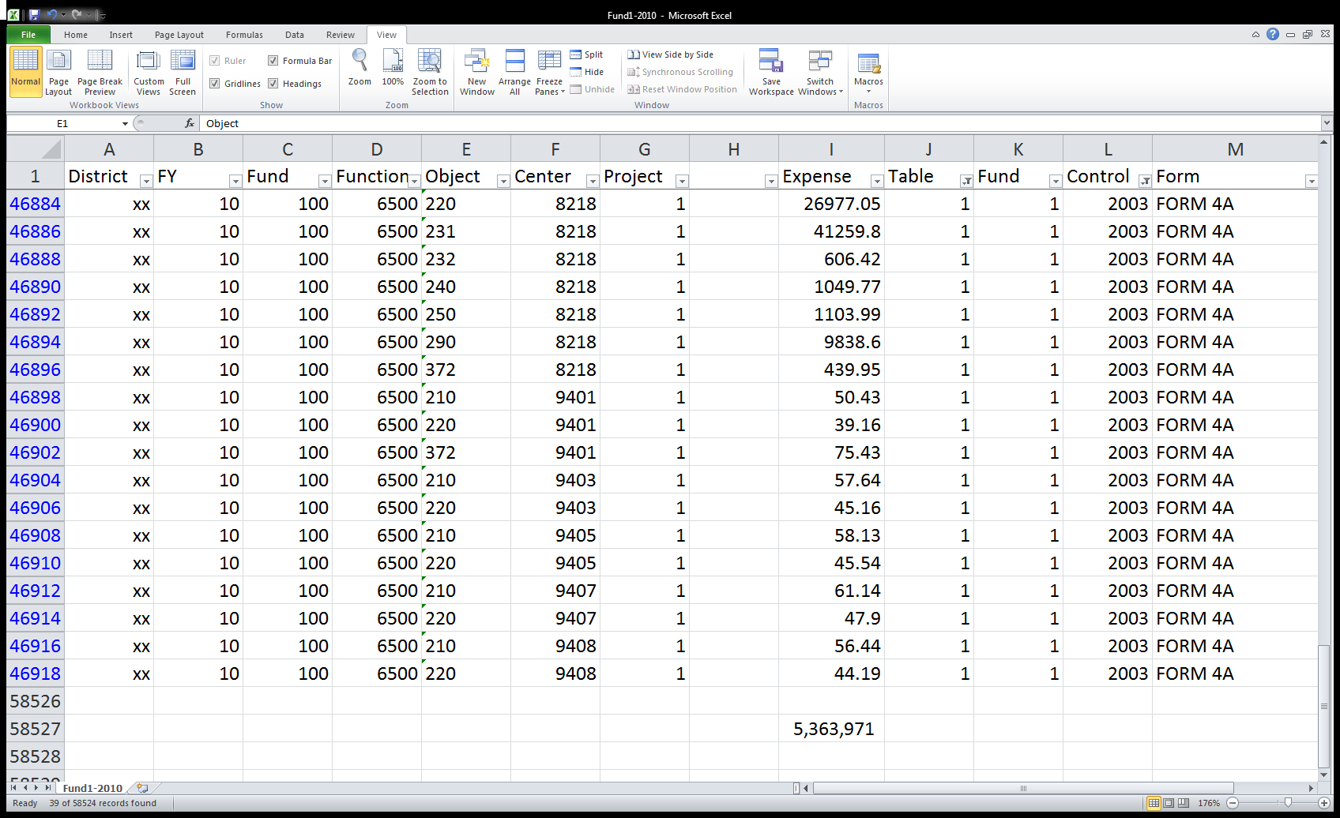
Finance Load Spreadsheet (Example #2)
Table 00001
Control 2003

Slide 8
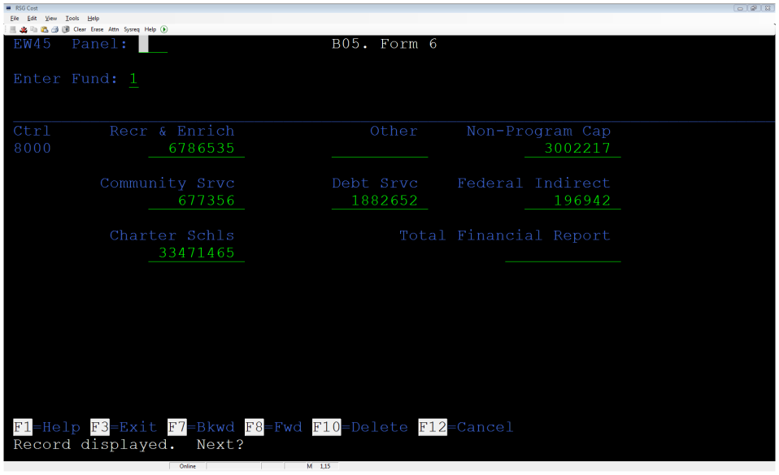
Finance Load Spreadsheet (Example #3)

Slide 9
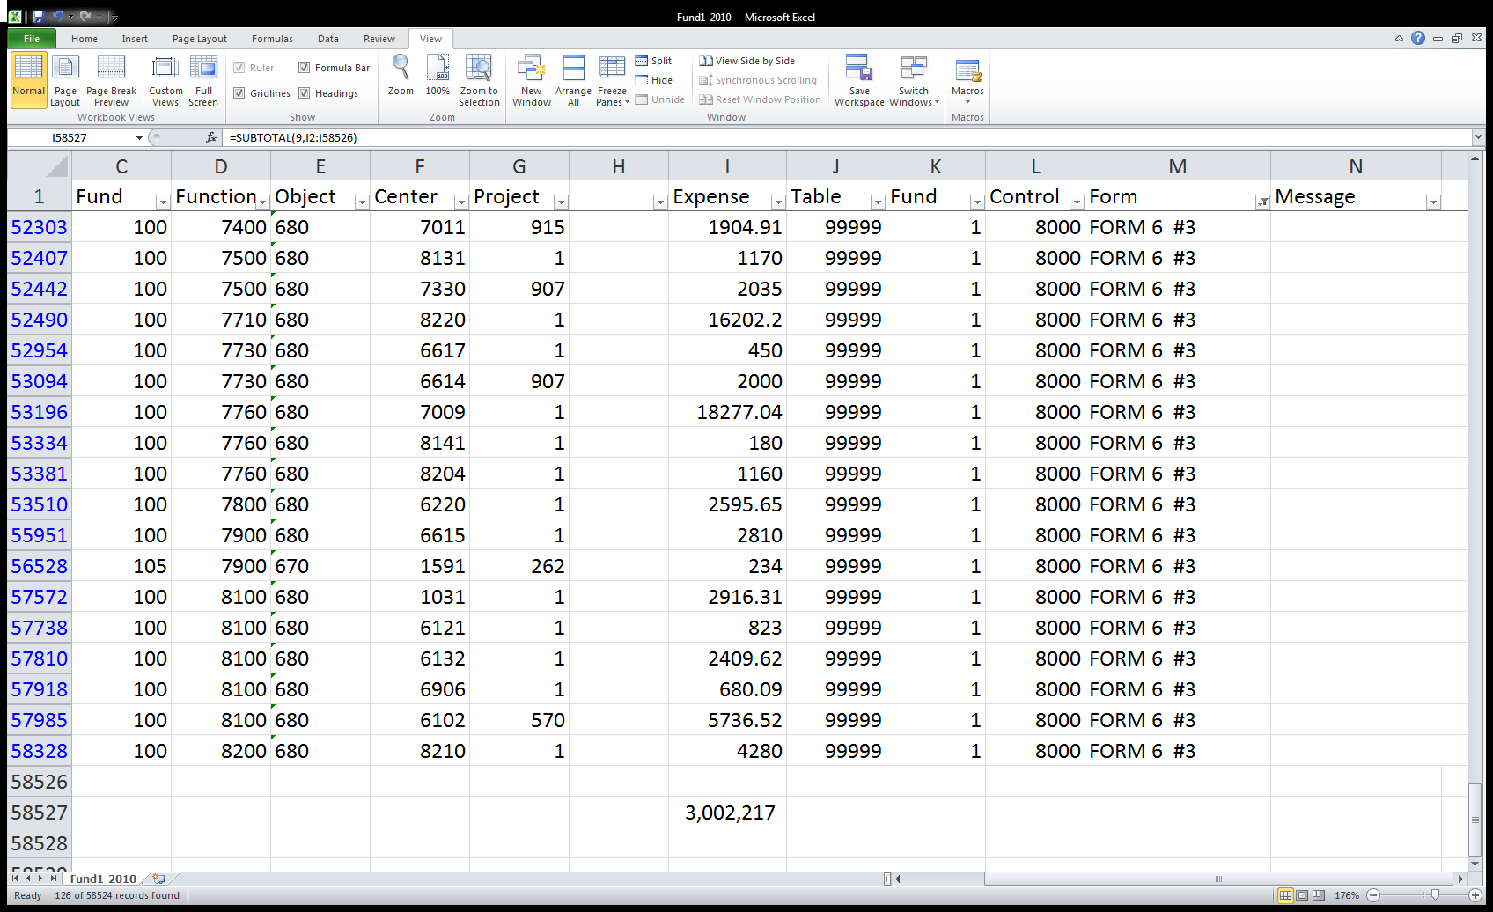
Finance Load Spreadsheet (Example #3)
Fund 1
Form 6 Field #3

Slide 10
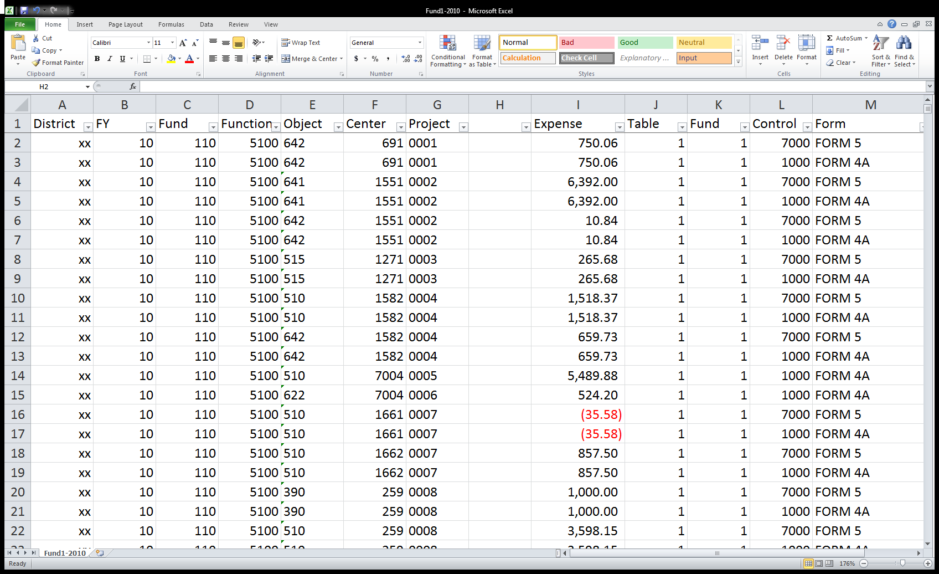
Finance Load Spreadsheet (Source Document)

Slide 11

Finance Load Spreadsheet (Source Document)

Slide 12
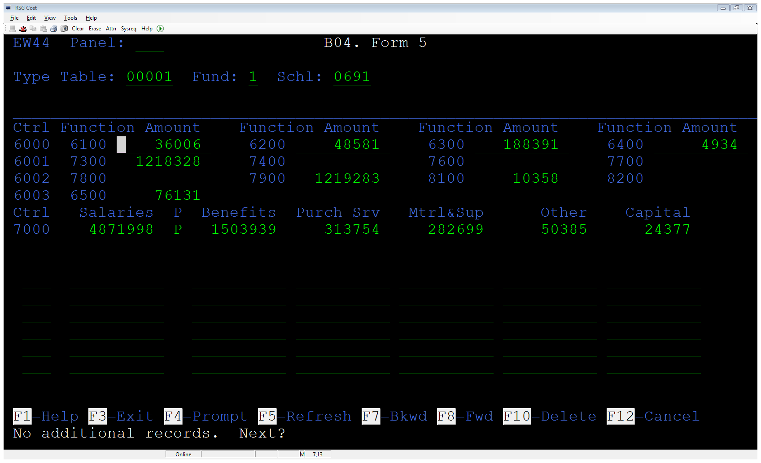
Finance Load Spreadsheet (Source Document)

Slide 13
Finance Load Spreadsheet
What does IT need to know?
  Changes needed in local program that reads Chart of Accounts and builds Cost Data File (EWCDFx)
  Create a new text file to record how accounts map to Forms 4a, 5, and 6
  When ever the program writes to the Cost Data File it should also write to the new text file
  If the data is written to the text file with a comma in between each data element, it can then be imported in to Excel.

Slide 14

Early Processing of Cost Report
2
Does this make sense for my district?

Slide 15
Early Processing of Cost Report
What do we gain from this?
  Extra time to process the Cost Report
  Better access to school employees who can answer questions about who really taught the classes
What are the limitations?
  You can only work on Phase I (SATSY) early
  Job #s must be unique between 1st and 2nd processing of records

Slide 16
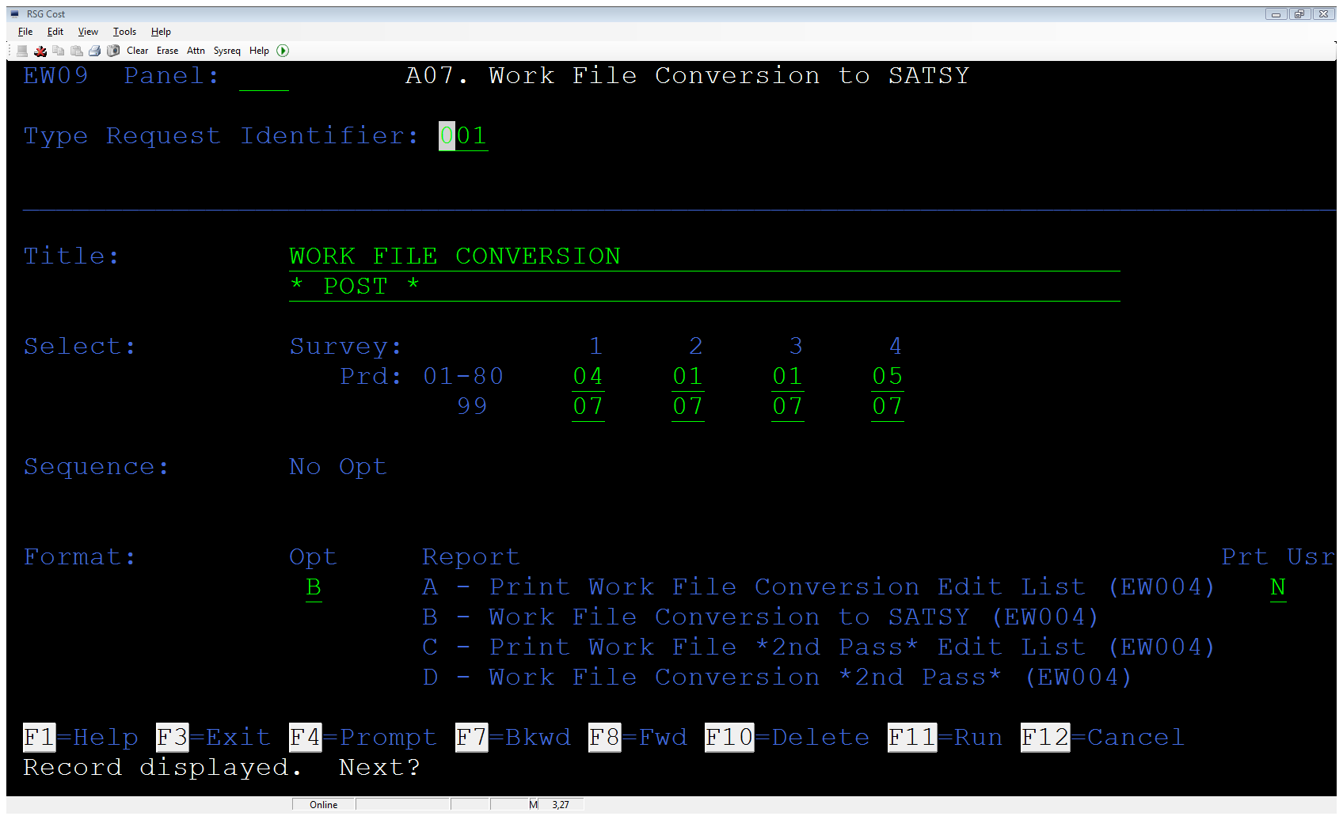
Early Processing of Cost Report (Unique Job Numbers)

Slide 17
Early Processing of Cost Report
1st Pass Processing
  We Process K-12 Surveys 1, 2, & 3. We do NOT process WDIS or Survey 4.
  We run programs EW001(Create SATSY Work File) through EW014(Staff Data Edit)
  Payroll Load program will load Salary and Days worked based on values at roughly the end of survey 3
  Clean up SATSY records at district office or by sending EW014 reports out to schools

Slide 18
Early Processing of Cost Report
2nd Pass Processing
  Load K-12 Survey 4 and all WDIS Surveys
  Backup SATSY records
  Run programs EW001 through EW014
    A “2nd Pass” version of EW004 is run so as to merge the new SATSY records with the 1st Pass SATSY records
    A “2nd Pass” version of EW005 is run to purge and rebuild the 5x records and reload all of the STH fields

Slide 19
Early Processing of Cost Report
What are we updating in the 1st Pass?
  Deleting records that don’t belong, like contract employees
  Correcting Mod records when the teacher worked a survey but doesn’t have students attached
  Researching/correcting records that come across with out a matching employee # in payroll

Slide 20
Early Processing of Cost Report
What is not being updated in the 1st Pass?
  Job 5x records because they are re-build in the 2nd Pass
  Salary totals, because those are re-loaded in the 2nd pass

Slide 21
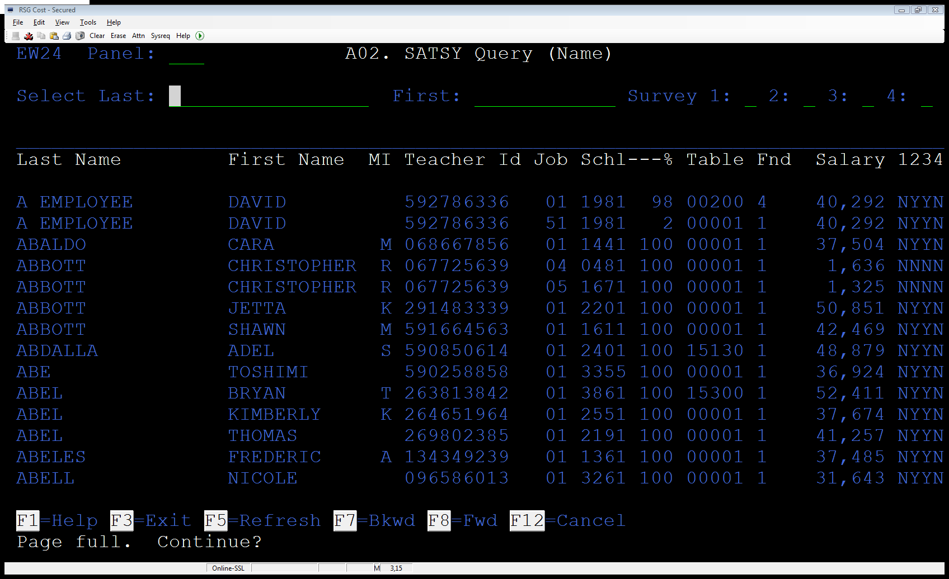
Early Processing of Cost Report (Example #1)
Names / Teacher Ids removed

Slide 22
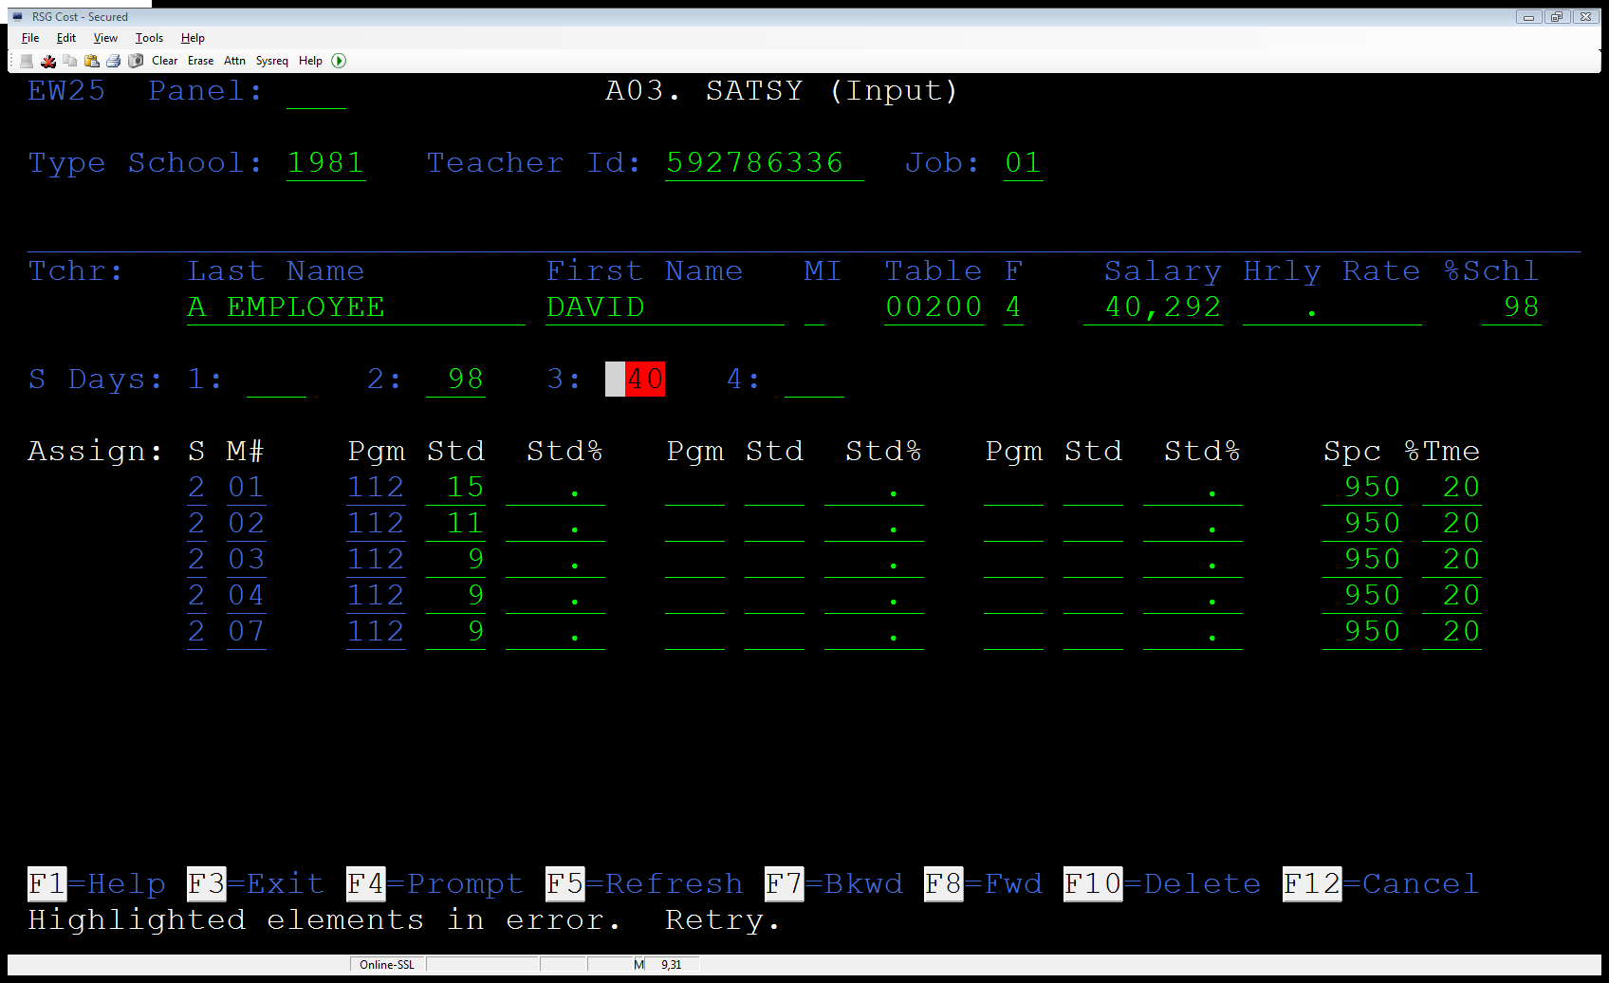
Early Processing of Cost Report (Example #1)

Slide 23
FISH File Interface
3
What does this get me?

Slide 24
FISH File Interface
What is the FISH File?
  Florida Inventory of School Houses
  Basically contains a list of every classroom in a district. And includes the size (Square Foot) of each classroom
  This file is created and reported by each district to DOE
Where would it Interface?
  Load Space program (EW002)

Slide 25
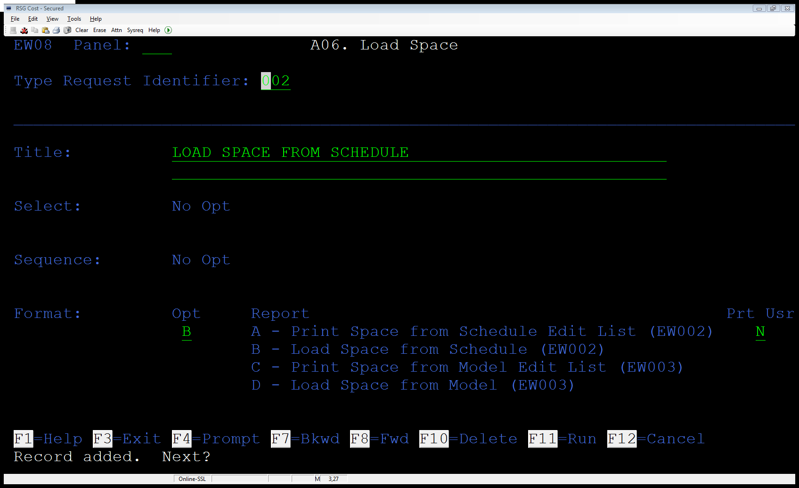
FISH File Interface

Slide 26
FISH File Interface
What do we gain from this?
  Increased accuracy over using the Space Model
  If the Load Space from Schedule (EW002) program is already interfaced with your local student system, than you don’t gain anything.

Slide 27
FISH File Interface
What does IT need to know?
  Modify the Create SATSY Work File (EW001) and the Create SATSY Work File (EW035) programs to record the 21 character Classroom ID # from the Teacher Course and WDIS Teacher Course Files.
  The Load Space from Schedule (EW002) program should be modified to read the FISH file using the 21 character Classroom ID # .
  A program may be needed to load the Fish File in to a format more easily read by the modified version of EW002.

Slide 28
Cost Report Q & A
Rapid Solutions Group, Inc.
WWW.RAPSG.COM
407-523-9231
David Dean
DDEAN@RAPSG.COM

